Slide 1

Daily report for CEO

Slide 2

Agenda
UI for report
Special function in report

Slide 3
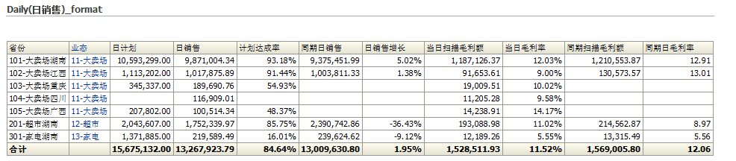
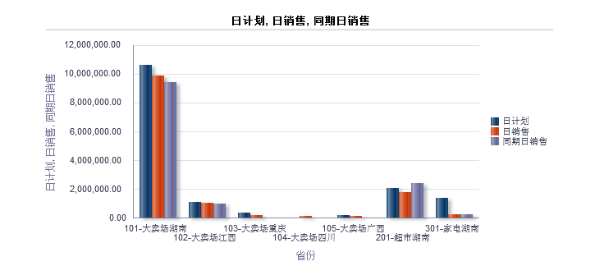

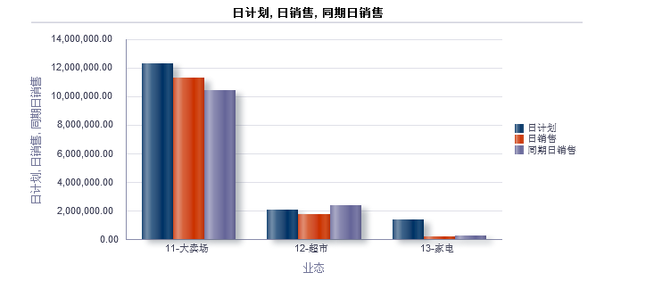
UI for report
UI for table
UI for graph
Notes:
核对2013与2012年的历史数据。不考虑2011年的数据。

Slide 4
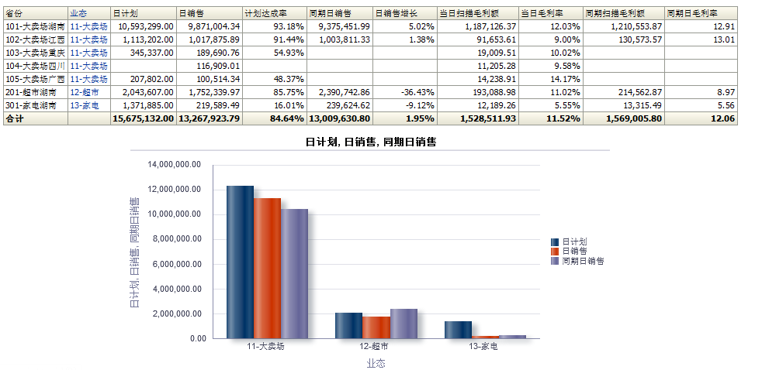
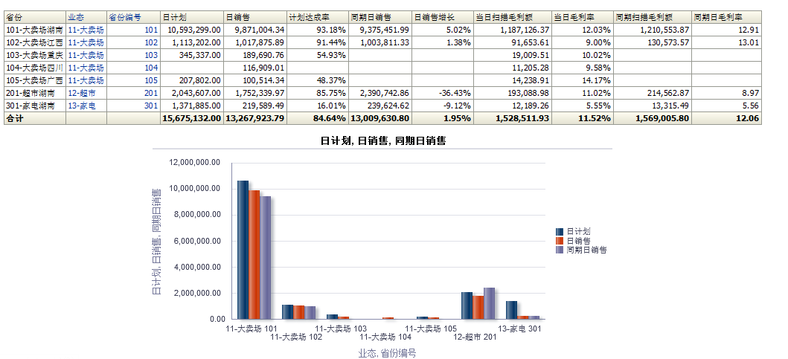

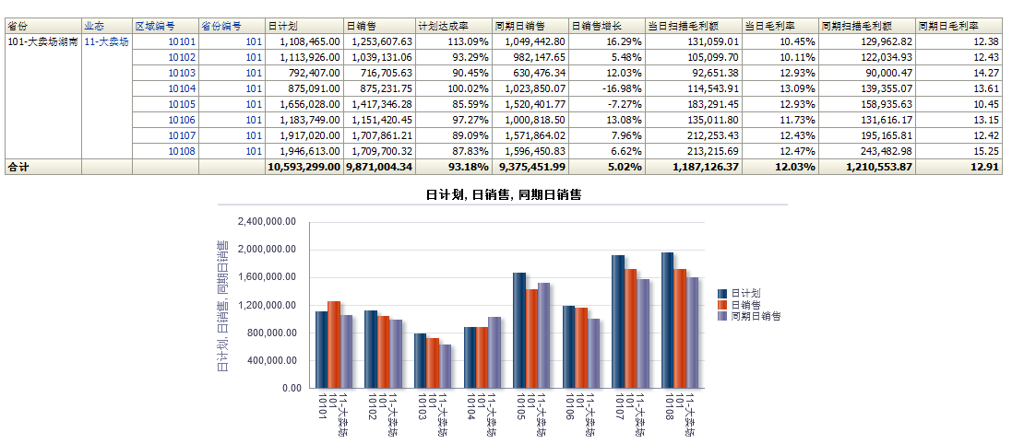
Special function
Drop function
Drop by title
Drop by value

Slide 5

Thank you

